Slide 1

ADVANCING THE LABORATORY PROFESSION AND NETWORKS IN AFRICA
Programmatic and technical benefits and challenges of laboratory networks and technologies – Uganda Experience
Charles Kiyaga
Technical Lead LabCoP Project
African Society of Laboratory Medicine (ASLM)

Slide 2
Disclaimer
I have no conflicts of interest

Slide 3
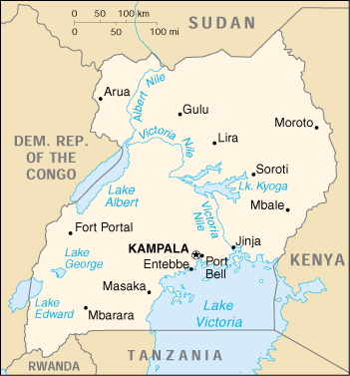
Originally Uganda’s EID Laboratory network comprised 8 regionally based partner laboratories
x
Manual lab
Fully automated lab
x
x
Challenges posed included;
High over head costs ($22.2/test)
Long turn around time(over 2months)
Poor program coordination and
MOH oversight
Poor data management and program
monitoring etc.
x
x
x
x
x
x
x

Slide 4
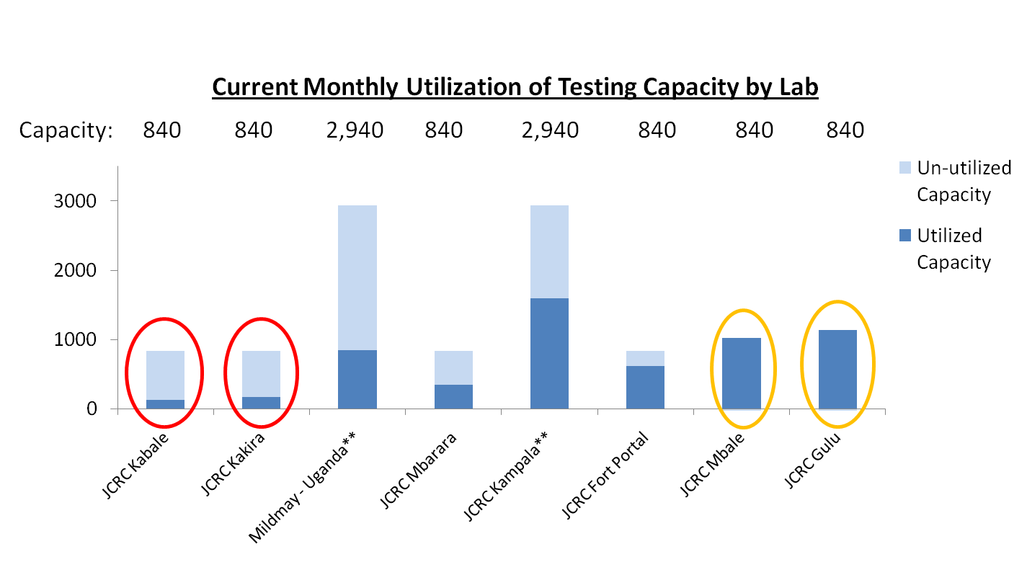
Poor distribution of sample volumes led to under or over utilization of laboratory capacity resulting in long TAT and high overhead costs
Samples over-capacity
Particularly low volume labs wait for multiple weeks in order to accumulate 20-40 samples for a batch, delaying the processing of samples that arrived early
Other labs are receiving more samples than they have capacity to process in time with manual testing methods
** Labs with asterisks were fully automated and thus have a higher sample capacity

Slide 5
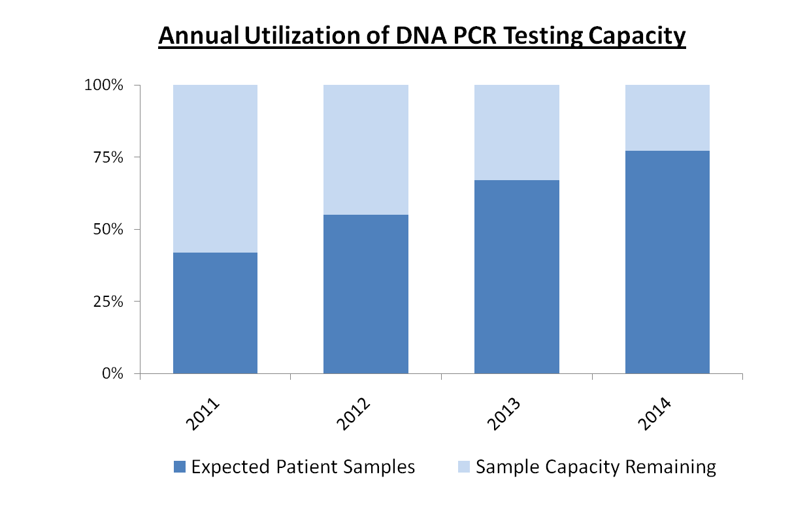
In general, the testing laboratory network was operating well below capacity
Even after 4 years, utilization of lab testing capacity would only be at 77%
130,000
130,000
130,000
130,000
Based on these observations, a
decision was taken to re-evaluate the laboratory capacity and network, to best suite the country needs
100,503
77%
71,612 55%
86,994
67%
54,420 42%

Slide 6
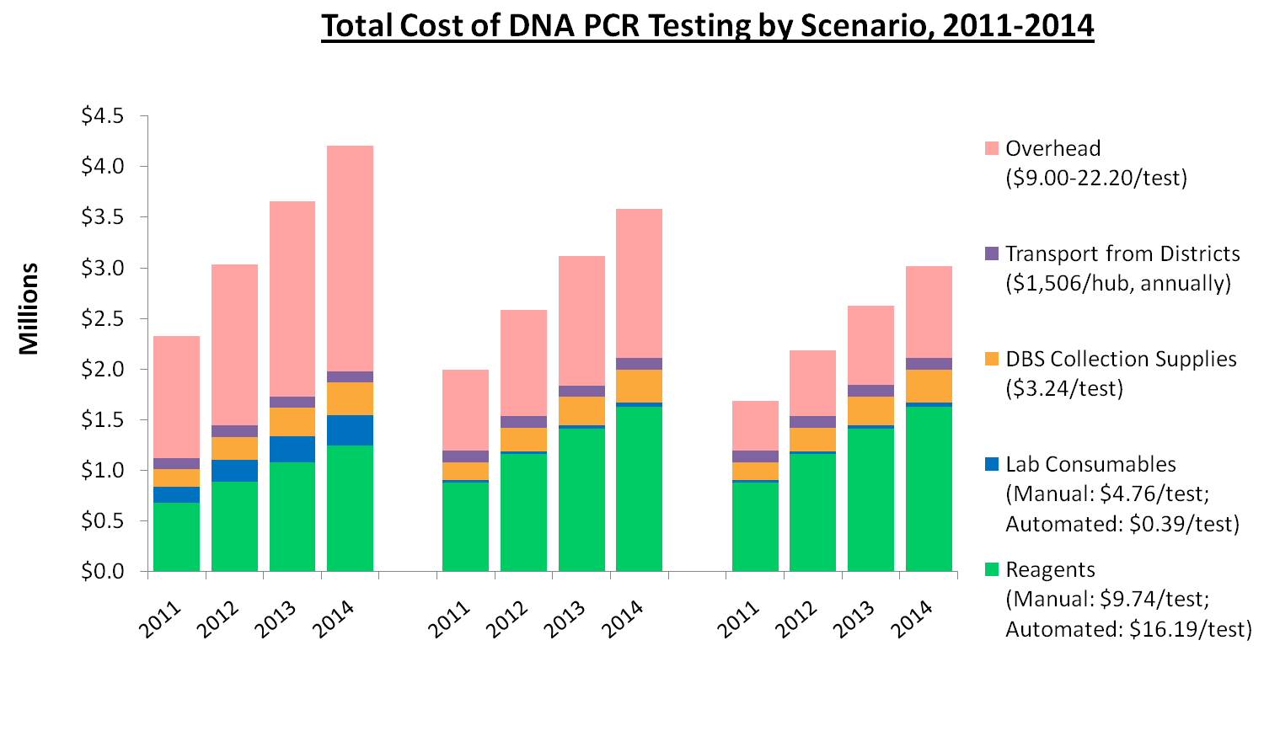
Three scenarios were evaluated; 8 Lab, 4 Lab and 1 Lab scenarios. It was found that 1 Lab scenario was most cost effective and would save the country nearly $4M over the next four years
Total Cost: $13,226,967
Total Cost: $11,265,289
Total Cost: $9,511,930
Current Scenario: 8 Labs
4 Lab Scenario
1 Lab Scenario

Slide 7
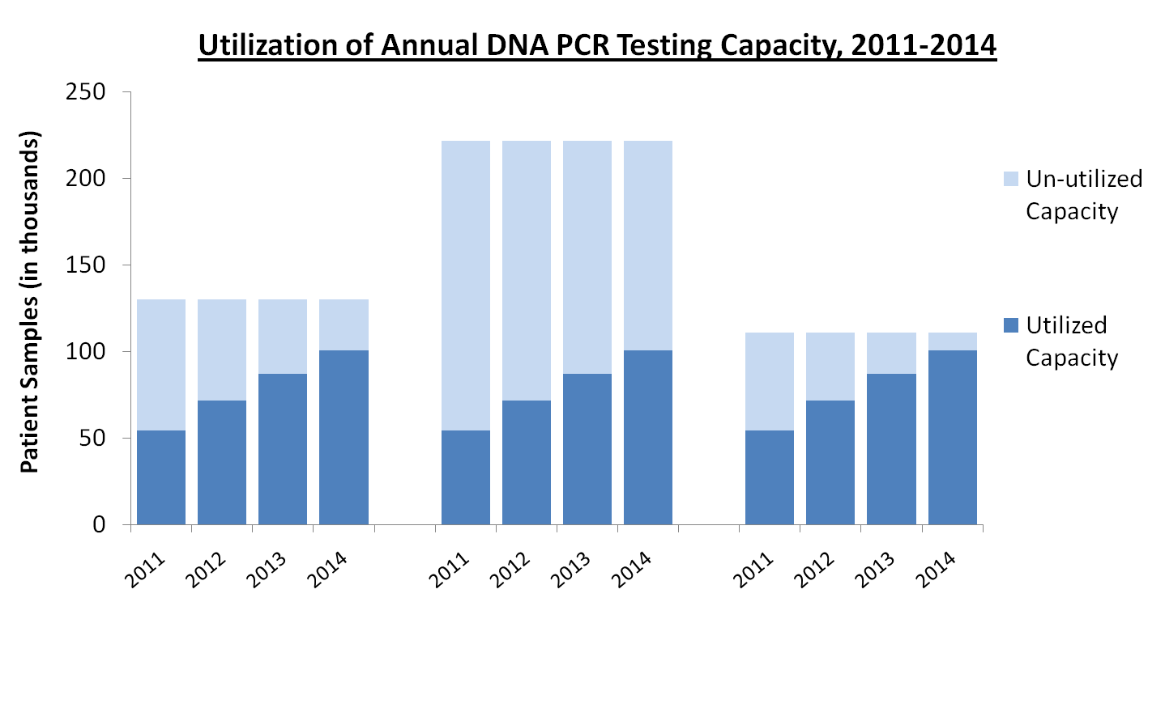
Overall, the testing laboratory capacity is also best utilized in the 1 Lab scenario
Capacity: 221,760 Samples Annually
Capacity: 130,000 Samples Annually
Capacity: 110,880 Samples Annually
77%
45%
91%
67%
39%
78%
55%
32%
49%
65%
42%
25%
Current Scenario:
6 Manual,
2 Automated
4 Automated Machines
(4 Labs)
2 Automated Machines
(1 Lab)

Slide 8
The consolidated EID laboratory become operational in July 2011 and proved more efficient and cost effective
To make the centralized EID lab accessible, a hub based sample transport network was formed.
From 2011 when the EID lab was set, the number of samples being tested increased substantially.

Slide 9

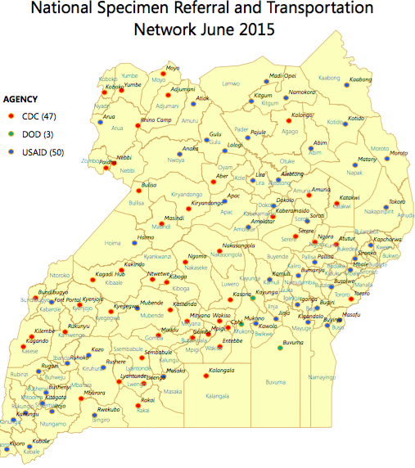
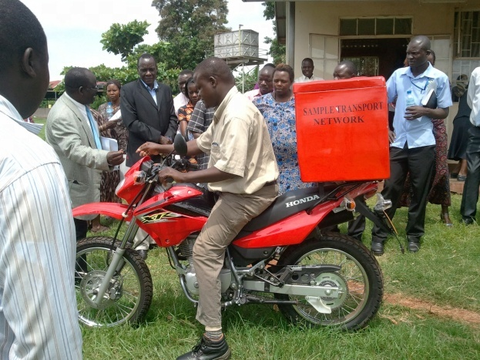


A good sample referral system increases the testing coverage of the laboratory network
GIS-mapping of facilities and road network a 30 to 40km radius around the hub
100 hubs reaching 2500 to 3000 health facilities
~90% coverage)
Rider reaches each of the 20 to 30 health facilities under the hub catchment at least once a week,
At each visit:
  samples pick up
  results drop off
Model and good ideas are exported to Sierra Leone
Charles Kiyaga|ASLM

Slide 10
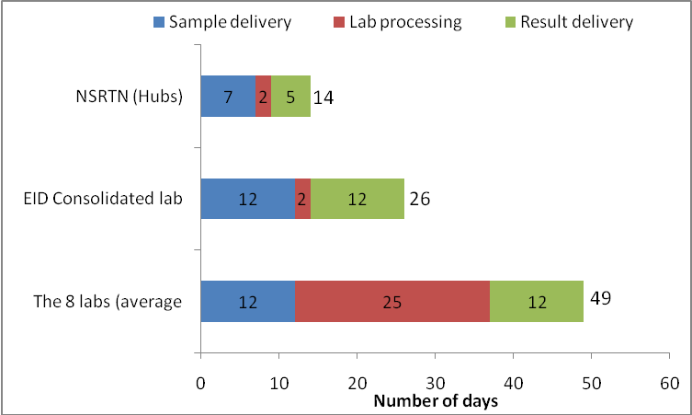
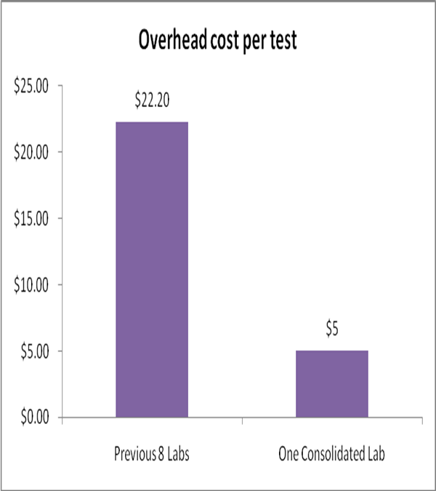
The impact seen after EID Consolidation from 8 labs to 1 lab
Marked reduction in result turn-around-time and overhead costs
In addition, the EID program availed efficient and cost-effective infrastructure such as IT systems, the Hub-based National Specimens Transportation Network, the electronic transfer of results and experience, which came in handy for other programs like VL, Hepatitis, sickle cell NBS, bacteriology surveillance etc.

Slide 11
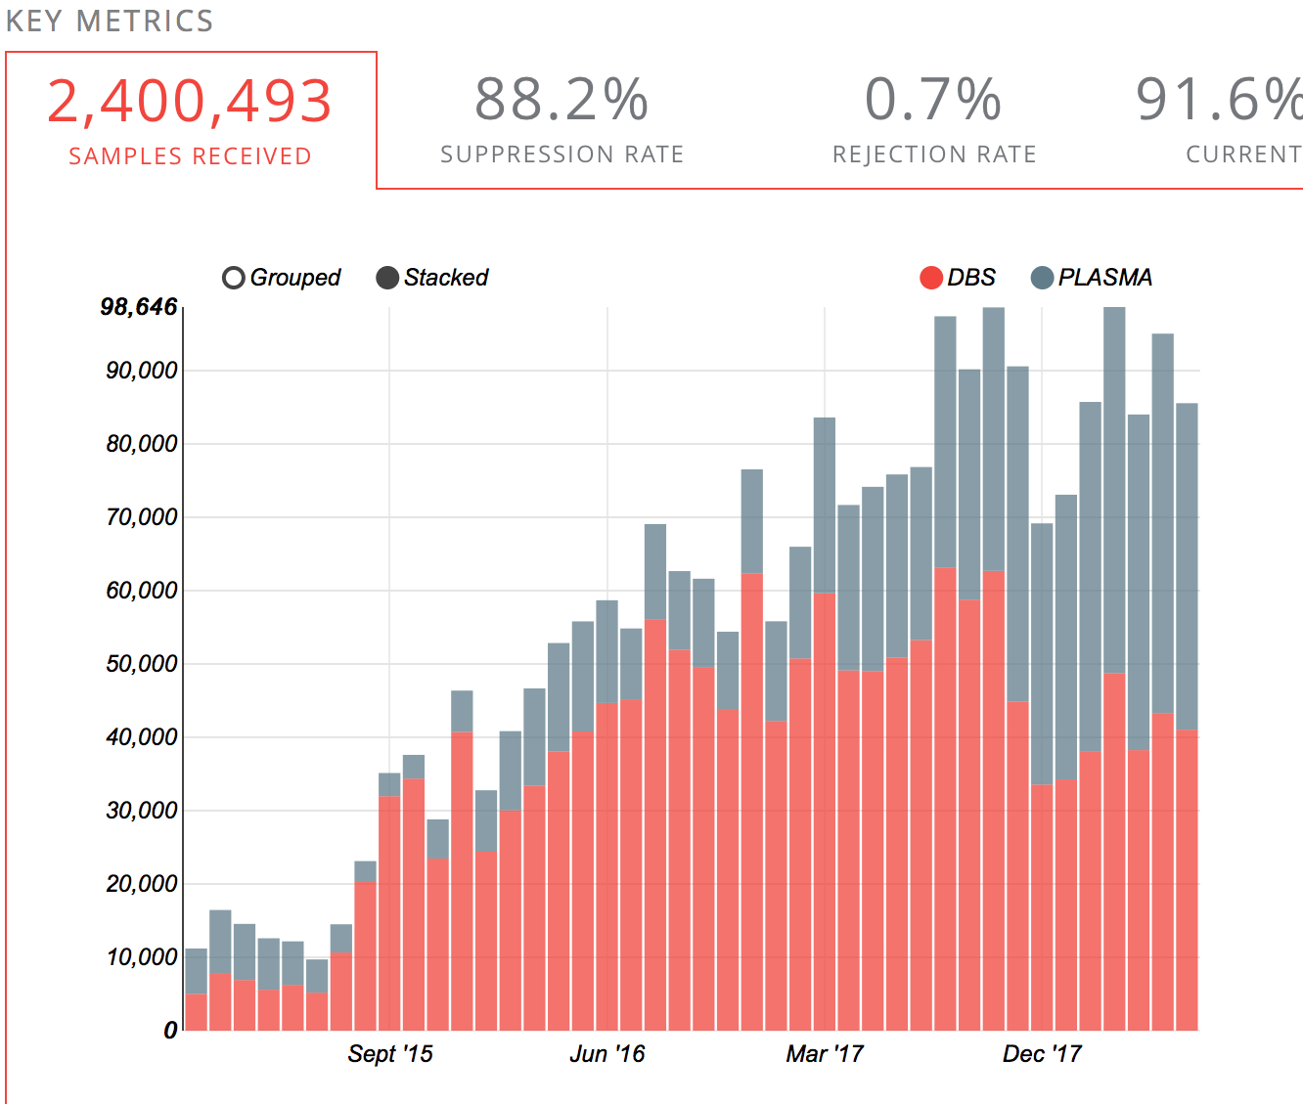
Though Using Centralized testing, Uganda’s EID and VL Programs are one of the most efficient on the Continent
The inherent weakness of centralized testing is the long TAT, which can be addressed through setting up a robust sample
Transport system and IT and LIMS infrastructure, to enable electronic results transfer. This would be far cheaper than
addressing the HR, QC, SCM, Data and Waste management, Equipment maintenance, infrastructure and overhead costs etc. that may be posed by large scale POC implementation. Nevertheless POC has a place to complement centralized testing which should be the backbone.

Slide 12
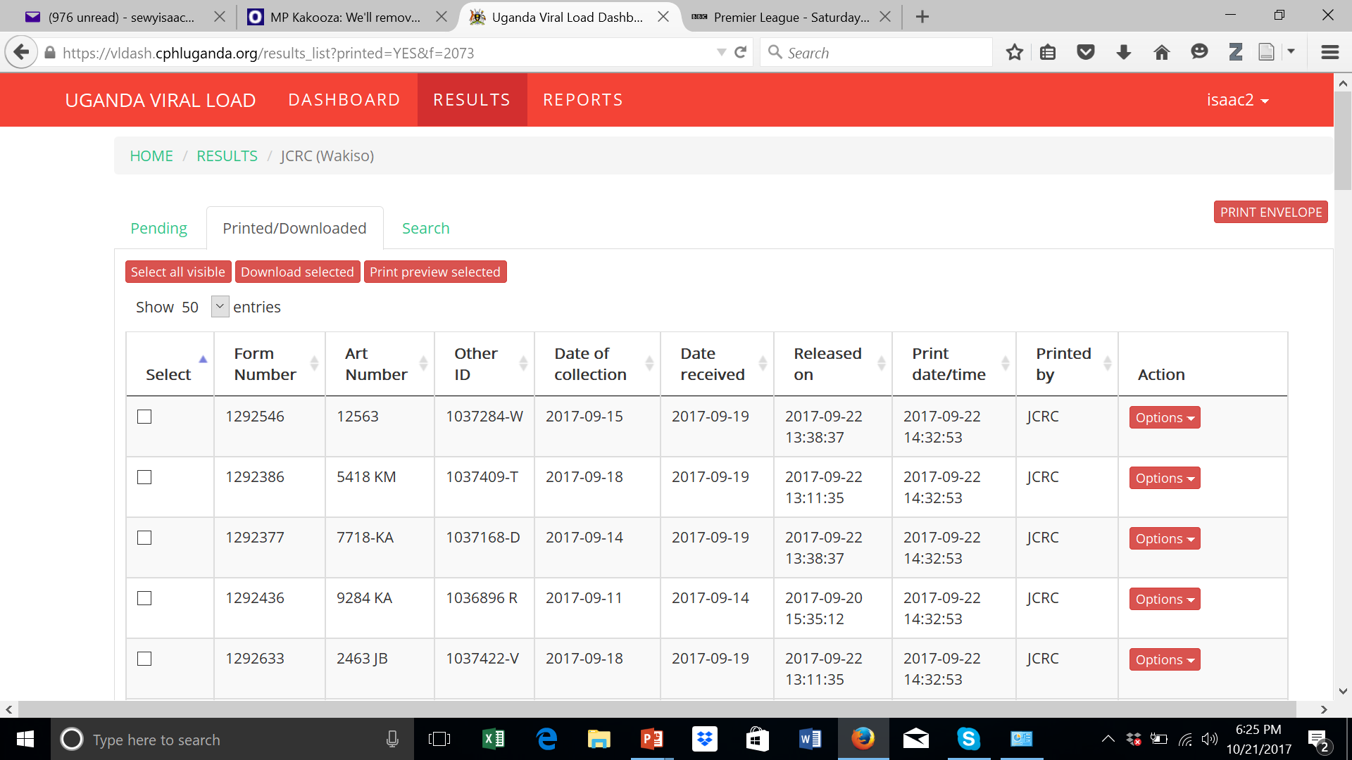


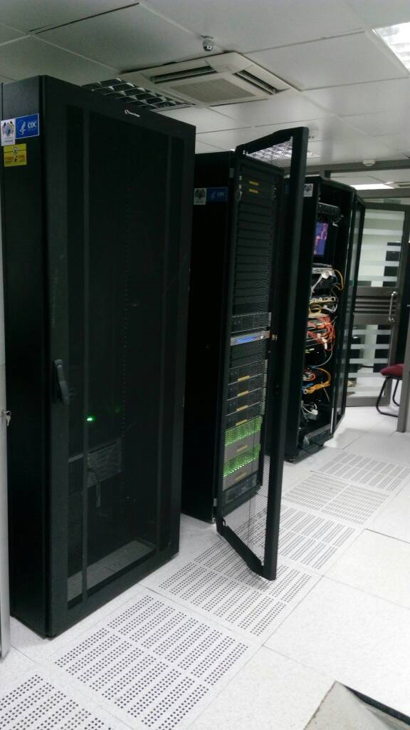
Electronic transfer of results has enabled H/F with internet to access results instantly reducing TAT to one week or less

Slide 13
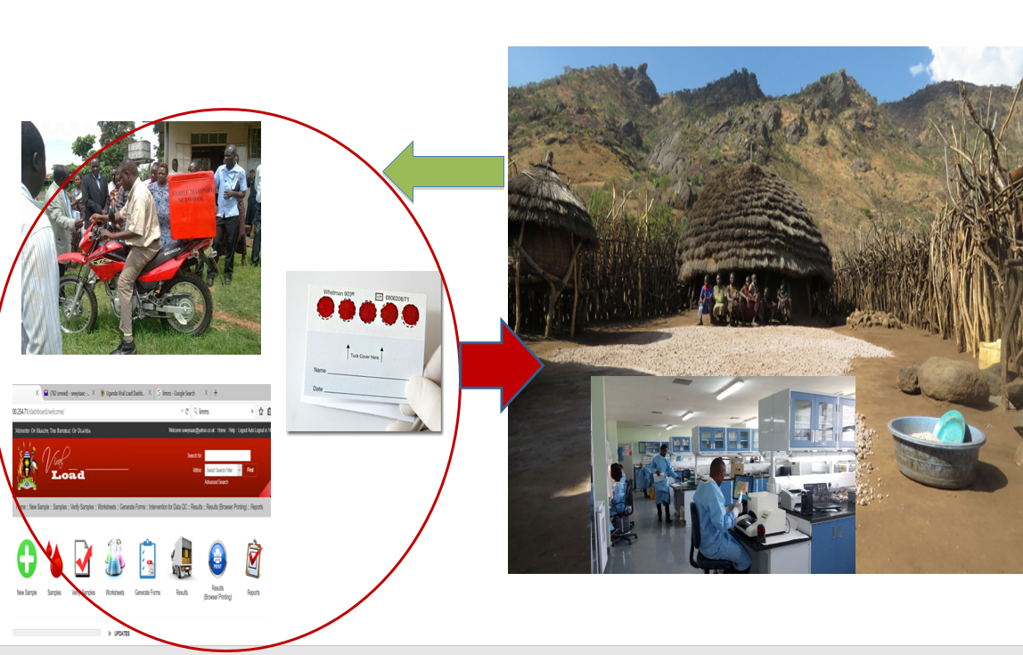
Contribution of all innovations deliver high quality lab service to the country courtyards at affordable cost

Slide 14
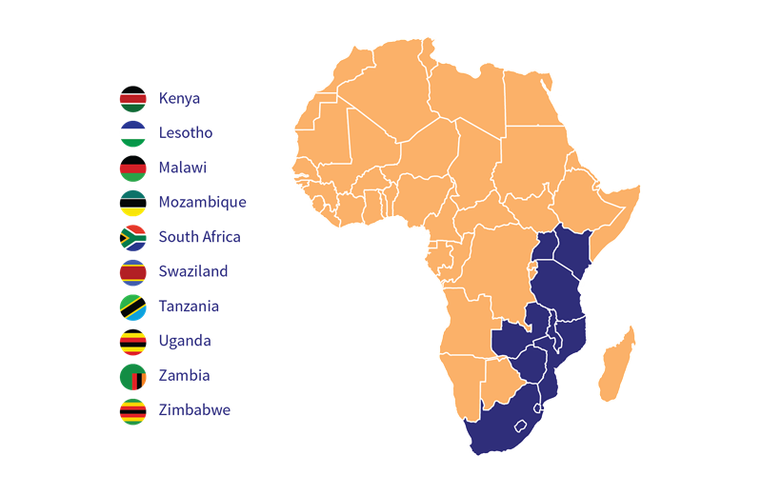


How can less funded countries benefit from advancements made in VL scale up?
How do improvements along the viral load cascade benefit other diseases?
How to bring all stakeholders in the discussion?
HIV
STI
NCD
EID
TB, Mal,
Laboratory
?
Program managers
clinicians
Civil society
Policy makers
DOZENS OF COUNTRIES LEFT OUT OF NEW PEPFAR STRATEGY, THREATENING THE GLOBAL AIDS RESPONSE
Plan Reflects Significant Resource Scarcity, Congress & Administration Failure to Provide Sufficient Funding
Implementing & developing partners

Slide 15



The laboratory system strengthening Community of Practice
A Bill & Melinda Gates funded platform:
For exchange and discussion between multiple countries and stakeholders
For the fast track identification, dissemination and adoption of ‘better ideas’
to improve laboratory system functions and accelerate the scale-up of HIV Viral Load testing for improved patient management
Countries are invited to join the network and are encouraged to select multi disciplinary teams

Slide 16

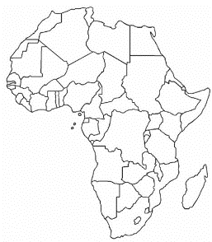

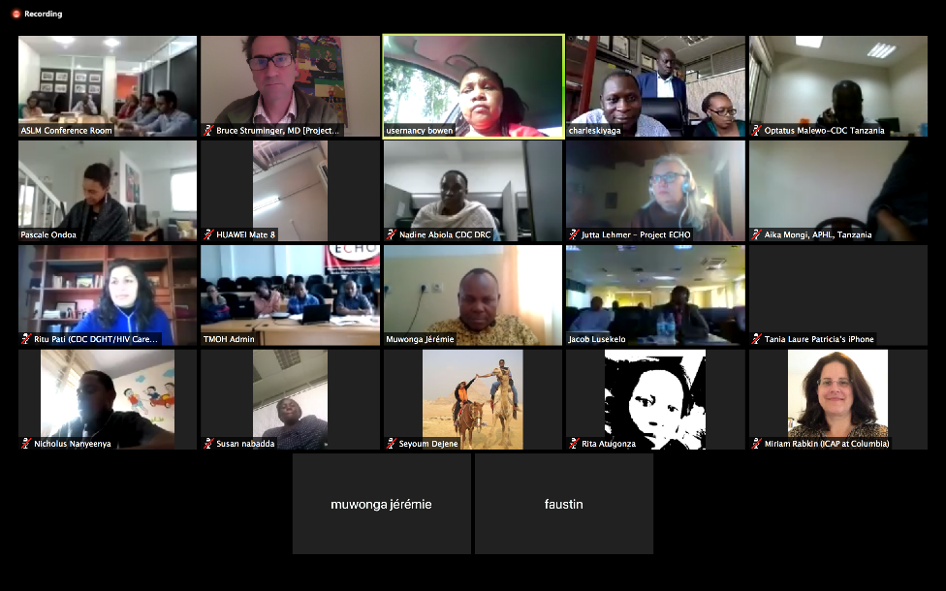

Country visits
Virtual ECHO sessions
VL testing cascade assessment
Identification, dissemination & adoption of best practices
Technical Assistance
Accelerate VL scale up and Strengthen Laboratory systems

Slide 17

How the Lessons were Transferred to Sierra Leone
We did a baseline assessment to understand the gaps and the confounders
Developed Training Materials, Data Tools and Job Aids that were adopted by stakeholders in country
The country already had one central VL laboratory which we optimized for high volume testing
Designed a sample transport system that is moving the samples to the testing lab
Developed a LIMS for the laboratory to start printing individual patient test results
Capacity Building started with TOT and the trained trainers have been the backbone of VL scale up
IT infrastructure/servers were set up which are enabling web based dash board monitoring
We supported the country set up a Supply Chain Management system

Slide 18




Thank you

